Slide 1











Taiwan’s
Chinese Language Education
Ministry of Education
Republic of China (Taiwan)

Slide 2





Why learn Chinese?
Why learn Chinese?
1
01
1
Chinese is the most spoken first-language in the world
16% of the world’s
population speaks
Chinese
1.3 billion
speakers
The Chinese-speaking market is enormous
Data source: Ethnologue
Notes:
相關補充資訊，請參考「民族語言網」
https://www.ethnologue.com/language/zho
https://www.ethnologue.com/guides/most-spoken-languages
English is the largest language in the world, if you count both native and non-native speakers. If you count only native speakers, Mandarin Chinese is the largest.

Slide 3








Study in Taiwan
Study in Taiwan
01
2
2
  Living in Taiwan
Study in
Taiwan
  Free, democratic, and safe society
  Taiwan ranked 14th in Forbes’ 2018 survey of the world’s 15 safest places to live.
  Comfortable and convenient living environment
  Taiwan ranked 1st for Quality of Life, and 2nd overall in the Best Places for Expats in the 2018 InterNations' Expat Insider report.
  Traditional Chinese characters reflect traditional Chinese culture
  Taiwan continues to use the traditional Chinese character forms. Learning these lets you more fully appreciate the Chinese language and culture across the centuries.

Slide 4


Learn Chinese in Taiwan
Learn Chinese in Taiwan
3
3
01
28,399 foreign students were learning Chinese in Taiwan in 2018 — mostly from Japan, Vietnam, and Indonesia — and about the same number of foreign students were studying for a degree there.

Slide 5
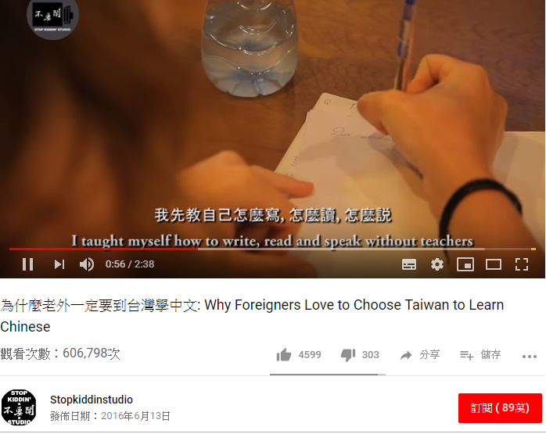
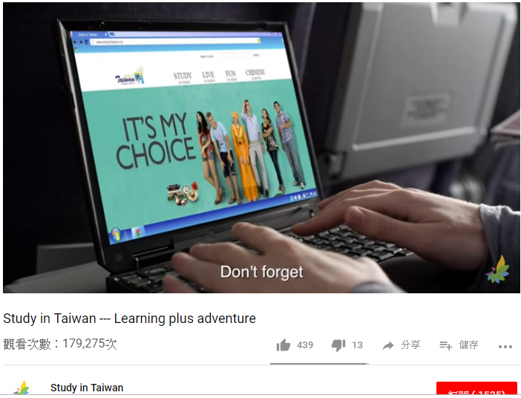









Why come to Taiwan to learn Chinese?
Why come to Taiwan to learn Chinese?
4
4
01

Slide 6

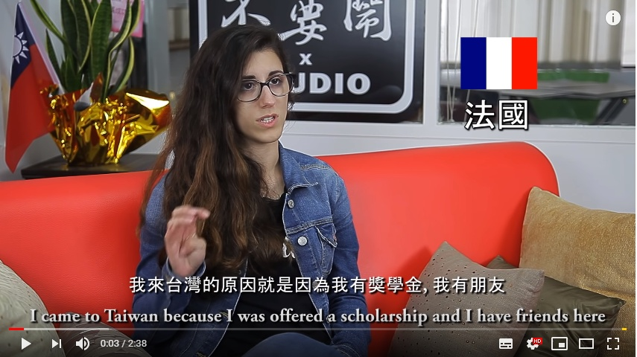
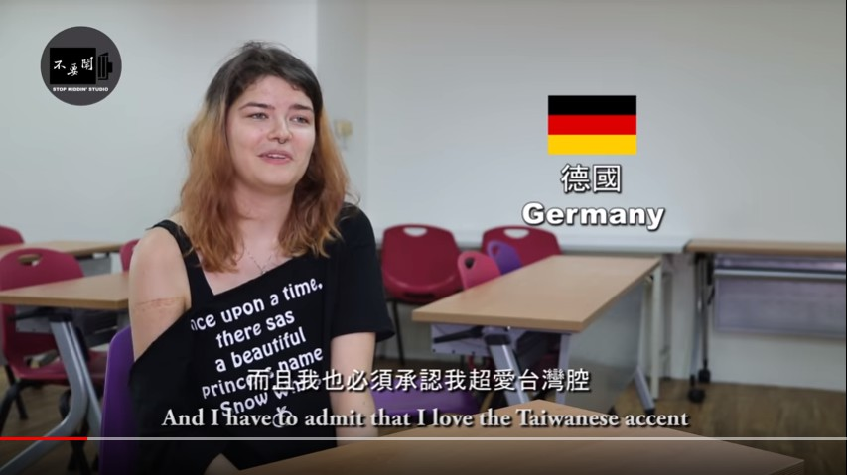
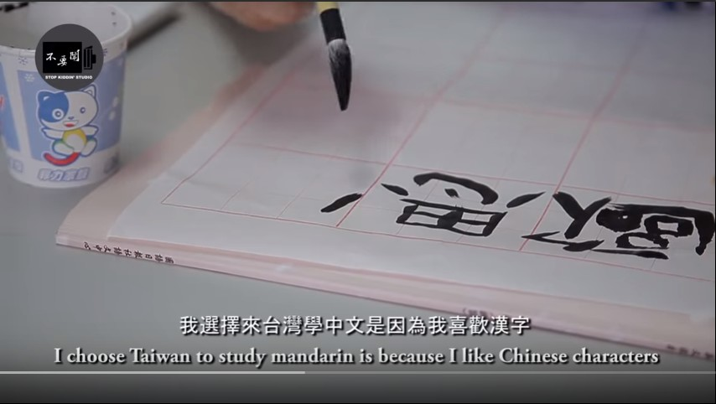
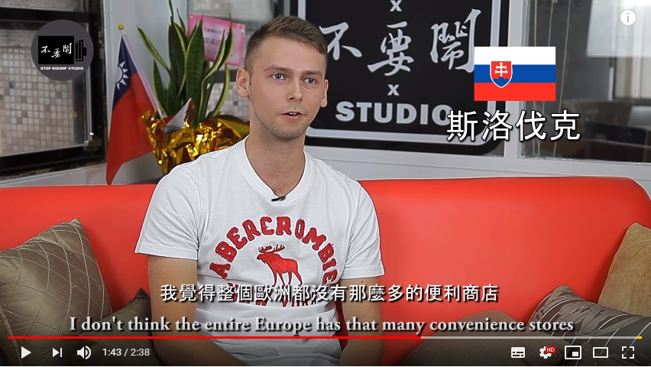
Reasons to choose Taiwan
Reasons to choose Taiwan
6

Slide 7




Learn Chinese in Taiwan
Individual applications
Learn Chinese in Taiwan
Individual applications
5
03
5
03
  Six easy steps to come and learn Chinese in Taiwan
  1. Choose a Chinese language center & course
  2. Contact the Chinese language center
  3. Prepare your application & check the submission date
  4. Submit your application to the center
  5. Wait for your admission notice
  6. Then apply for your visa
Huayu Enrichment Scholarship
List of Chinese language centers in Taiwan

Slide 8



Learn Chinese in Taiwan
Huayu Enrichment Scholarship
Learn Chinese in Taiwan
Huayu Enrichment Scholarship
5
5
  Huayu Enrichment Scholarship, HES
Scholarships available for Summer (2 months), 3 months, 6 months, 9 months, or 1 year
  Monthly allowance of NT$25,000
  - about US$800
Apply through Taiwan’s embassy or mission in your country

Slide 9






Learn Chinese in Taiwan
Learn Chinese in Taiwan
Study Tours
5
5
Study Tours
  Foreign student short-term Chinese study groups
  The MOE subsidizes the course fees by NT$4,000 per person per week.
Student groups from mainstream schools
A group must have at least 15 students
1~2 teachers may accompany the group
Chinese lessons 5 days a week, a minimum of 15 hours a week
Subsidies cover 2~4 weeks
  Mandarin On-the-Go in Taiwan
  Specially designed for tourists visiting Taiwan
  Universities in Taiwan have created half-day, one-day, and longer Chinese courses combining Chinese lessons & cultural experiences.

Slide 10


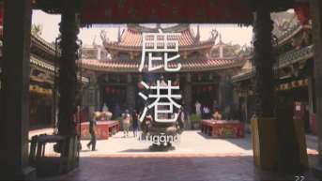


Learn Chinese online
Learn Chinese online
6
6
  Huayu 101
  “Learning Chinese: Start from Scratch”
  “Intermediate Chinese”
Conversational Chinese, ready to go
These courses are available free of charge
on Coursera, the world’s largest open
online learning (MOOC) platform.

Slide 11

Test of Chinese as a Foreign Language
Test of Chinese as a Foreign Language
7
7
Test of Chinese as a Foreign Language - TOCFL
324 tests were run in 33 countries in 2018 - for 59,776 test-takers.
Test level Certificate level |  | CEFR
Band Novice | Novice 1 | Pre-A1
 | Novice 2
Band A | Level 1 | A1
 | Level 2 | A2
Band B | Level 3 | B1
 | Level 4 | B2
Band C | Level 5 | C1
 | Level 6 | C2
Children’s Chinese Competency Certification
This is specially designed for children from 7 to 12 years old who aren’t
native speakers of Chinese.
Notes:
華測會每年皆於國內外辦理多場測驗，以因應世界各地華語學習之熱潮，迄107年底考點已分布於海外30國，考生人數達53,168人次，累積考生人數已逾30萬人次。在海外施測部分，本部依「海外施測計畫」補助我國駐外單位相關試務經費；另有海外教育機構以代理模式協助辦理施測事宜，代理單位依報考人數繳交相應權利金。
我國華語文能力測驗繼107年1月獲匈牙利教育辦公室語言測試認證中心採認後，又於同年3月獲越南教育培訓部正式公告採認證書，並將其納入該國高考語文科目中文項目免試之證明，加拿大溫哥華卑詩省教育廳也採認華語文能力測驗為外語學分之標準。
另外，華語文能力測驗業建立與美國外語教學委員會（American Council on the Teaching of Foreign Languages, ACTFL）及歐洲共同語言參考架構（Common European Framework of Reference for Languages, CEFR）可相對應之分級架構，與國外指標接軌。
為因應產業界及學界需求，華測會亦開發「快篩測驗系統」，由使用單位購買帳號，採雲端測驗，具有隨到隨考，即測即評特性，半小時就能精確評估受測者之華語文聽力或閱讀能力等級，可協助企業快速掌握員工華語能力、幫助學校進行新生華語能力分班作業等。

Slide 12



Chinese teacher training and teaching resources
Chinese teacher training and teaching resources
8
8
06
  Overseas Chinese language teacher training
1
The MOE provides subsidies for groups of 15 ~ 20 teachers who teach Chinese in mainstream schools, colleges, and/or universities to come to Taiwan for further professional training.
2
A subsidy of NT$2,000 per day is provided for 2 weeks, for each teacher who hasn’t had further professional training with an MOE subsidy in the last three years.
  Teaching resources
Learn more on the OGME website.

Slide 13

How to employ Chinese teachers
How to employ Chinese teachers
9
9
07
  Educational institutions that would like to employ native Chinese teachers can contact the MOE’s overseas education divisions
  Overseas educational institutions need to provide the following information:
 | Its location, and the name of the person responsible
 | Number of teachers wanted, duration, and teaching staff qualification requirements
 | Compensation - salary, and other aspects, such as insurance, accommodation, and training opportunities
 | Job description - teaching and administrative tasks
 | Information for applicants
 | Student description
 | Contact person, and contact details
Notes:
華測會每年皆於國內外辦理多場測驗，以因應世界各地華語學習之熱潮，迄107年底考點已分布於海外30國，考生人數達53,168人次，累積考生人數已逾30萬人次。在海外施測部分，本部依「海外施測計畫」補助我國駐外單位相關試務經費；另有海外教育機構以代理模式協助辦理施測事宜，代理單位依報考人數繳交相應權利金。
我國華語文能力測驗繼107年1月獲匈牙利教育辦公室語言測試認證中心採認後，又於同年3月獲越南教育培訓部正式公告採認證書，並將其納入該國高考語文科目中文項目免試之證明，加拿大溫哥華卑詩省教育廳也採認華語文能力測驗為外語學分之標準。
另外，華語文能力測驗業建立與美國外語教學委員會（American Council on the Teaching of Foreign Languages, ACTFL）及歐洲共同語言參考架構（Common European Framework of Reference for Languages, CEFR）可相對應之分級架構，與國外指標接軌。
為因應產業界及學界需求，華測會亦開發「快篩測驗系統」，由使用單位購買帳號，採雲端測驗，具有隨到隨考，即測即評特性，半小時就能精確評估受測者之華語文聽力或閱讀能力等級，可協助企業快速掌握員工華語能力、幫助學校進行新生華語能力分班作業等。

Slide 14

Cooperation with organizations
Cooperation with organizations
10
10
1. Joint skills training — non-profit organizations, universities
Offer outstanding foreign students a one-year internship together with a Chinese language course in Taiwan, to help them rapidly improve their Chinese.
2. Jointly funded scholarships — governments
Co-operatively establish Chinese Language Summer School scholarships and/or other scholarships to come to Taiwan to learn Chinese.
3. Jointly organized Chinese language courses — governments, NGOs
We provide financial assistance for outstanding Chinese teachers in Taiwan to offer short-term Chinese courses overseas, and for outstanding people from overseas to take Chinese language courses in Taiwan.
Notes:
「與他國相關合作計畫」：合作開設華語課程-政府、非政府組織部份，舉例如下：
本部曾補助我國優質華語教師為外國單位（圖書館、政府單位）辦理短期華語進修課程
休士頓警用華語課程熱鬧啟動 警民互動和諧融洽：https://epaper.edu.tw/windows.aspx?windows_sn=21061
另本部也曾依據「促進華語文教育產業發展補助要點」，透過舊金山教育組補助國外圖書館聘請教師開設華語課程之鐘點費
或補助海外菁英（如駐外人員、政府機關）來臺接受密集華語訓練課程。
歐盟官員來臺樂學華語並說明歐盟獎學金最新訊息：https://www.edu.tw/news_Content.aspx?n=9E7AC85F1954DDA8&s=B7F6E129E003D53B

Slide 15









Overseas events
Overseas events
11
11
1
2

Slide 16

Q&A
Thank you!

Slide 17


Study in Taiwan
Study in Taiwan

Slide 18
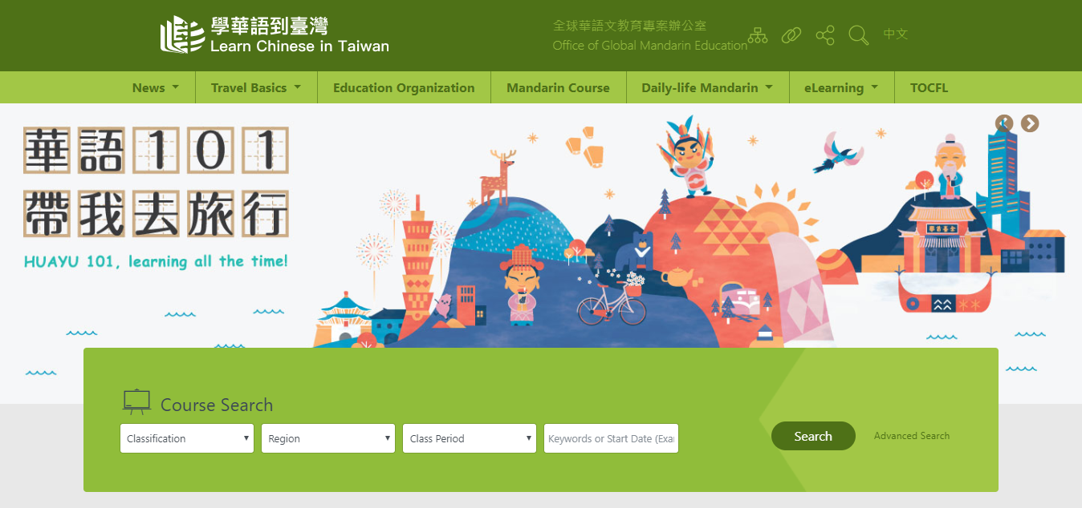
Find a Chinese language center
Find a Chinese language center

Slide 19
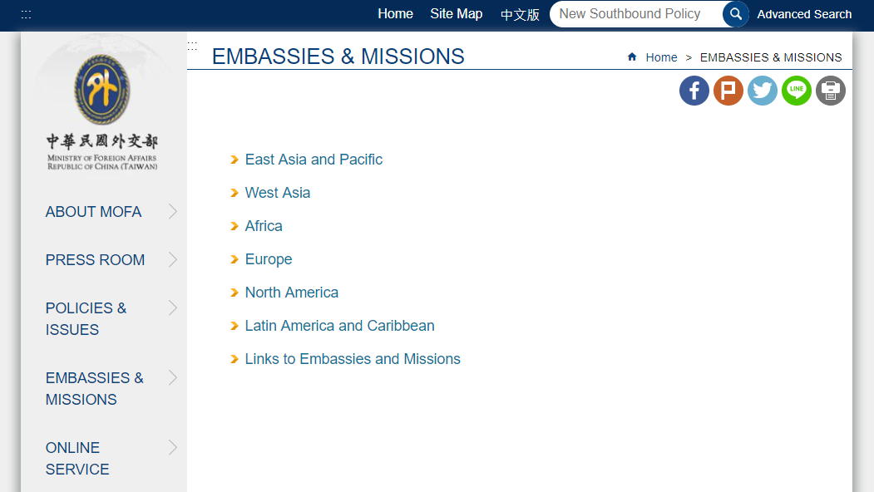
Local embassies & missions
Local embassies & missions

Slide 20
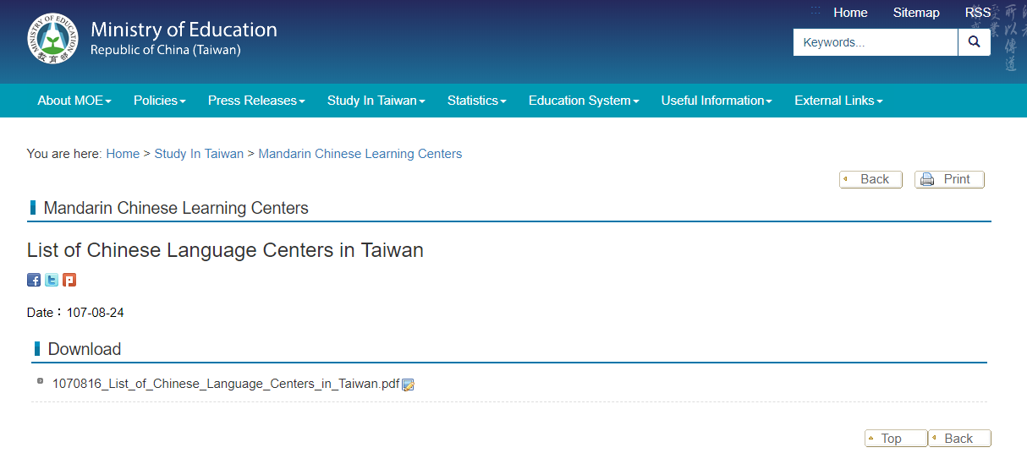

List of all 60 Chinese language centers in Taiwan
List of all 60 Chinese language centers in Taiwan

Slide 21
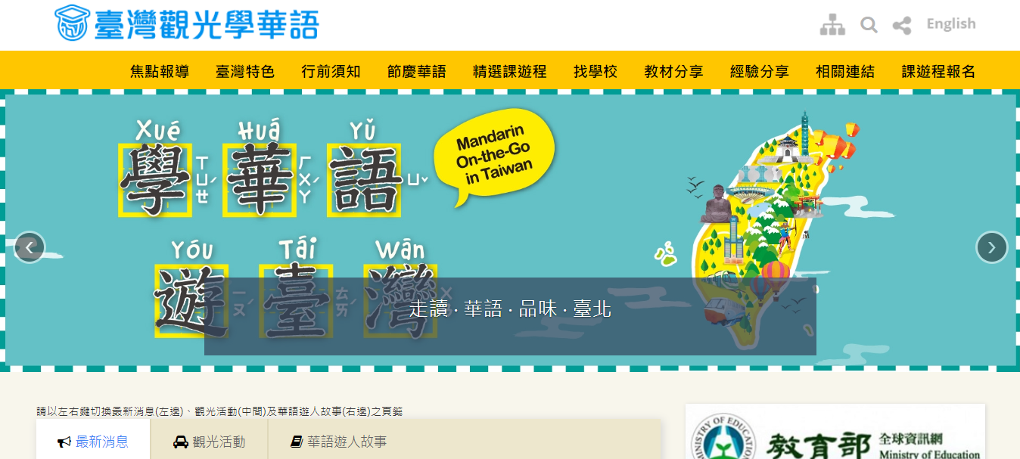
Travel and learn Chinese in Taiwan
Travel and learn Chinese in Taiwan

Slide 22
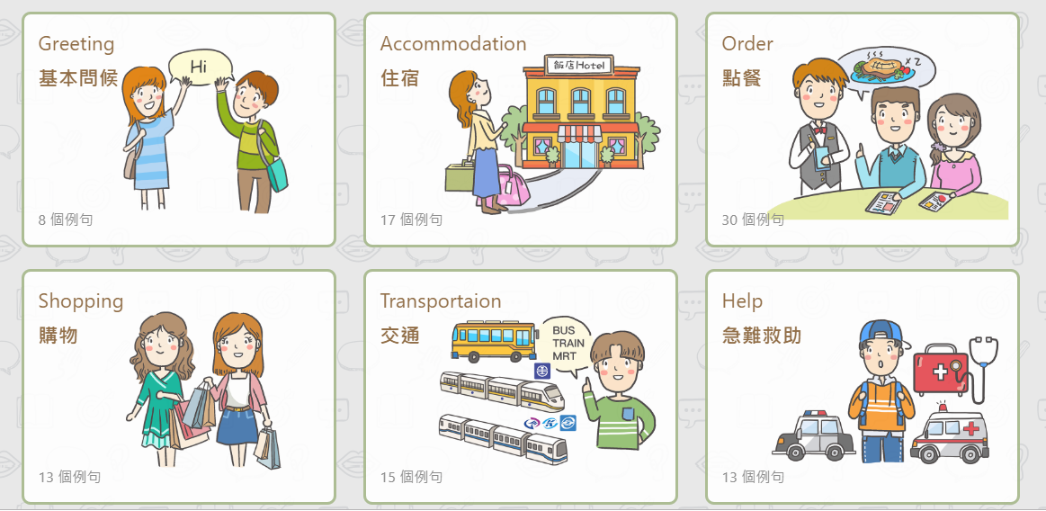
Huayu 101
Huayu 101

Slide 23
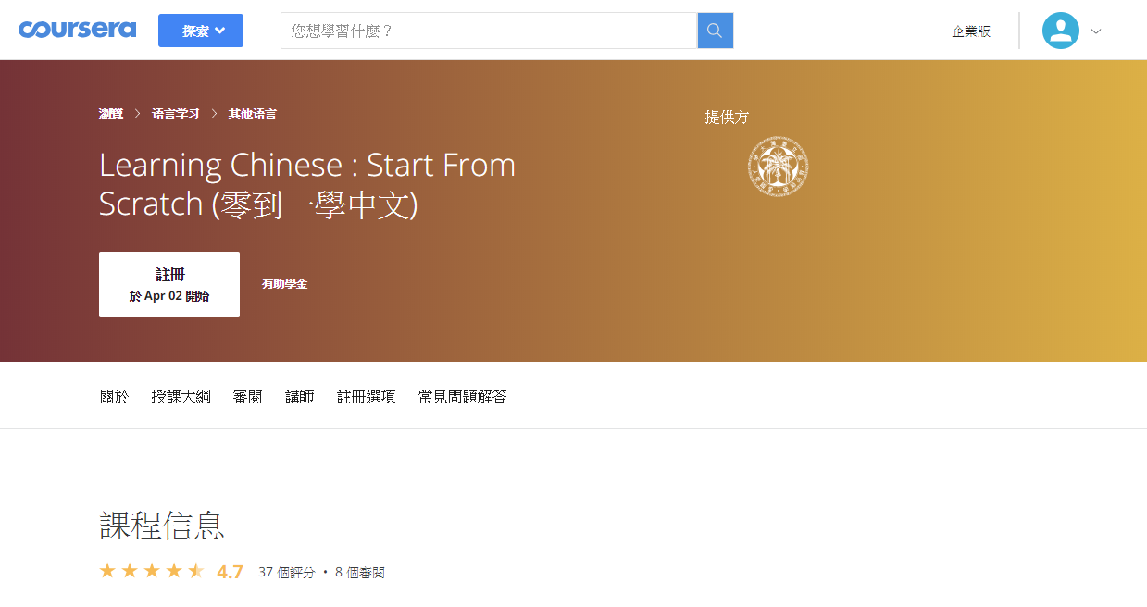

“Learning Chinese : Start From Scratch”
“Learning Chinese : Start From Scratch”

Slide 24
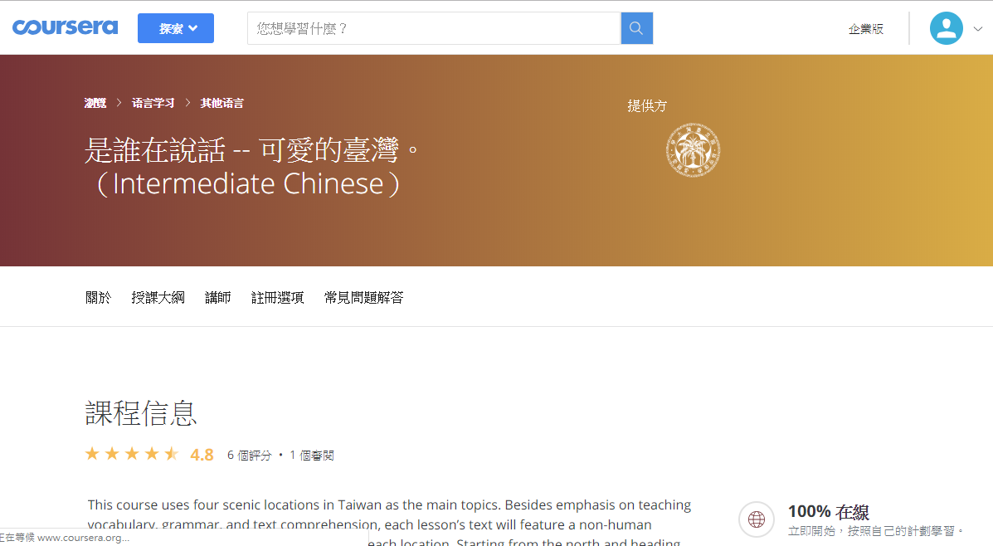
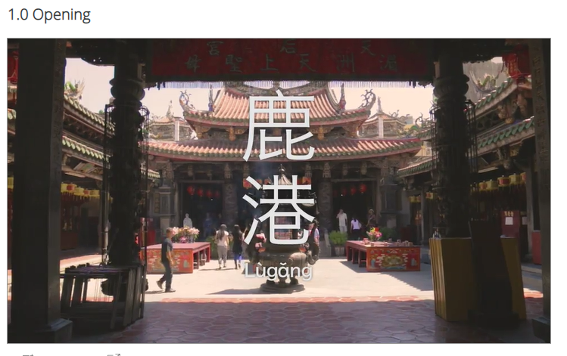
“Intermediate Chinese”
“Intermediate Chinese”

Slide 25
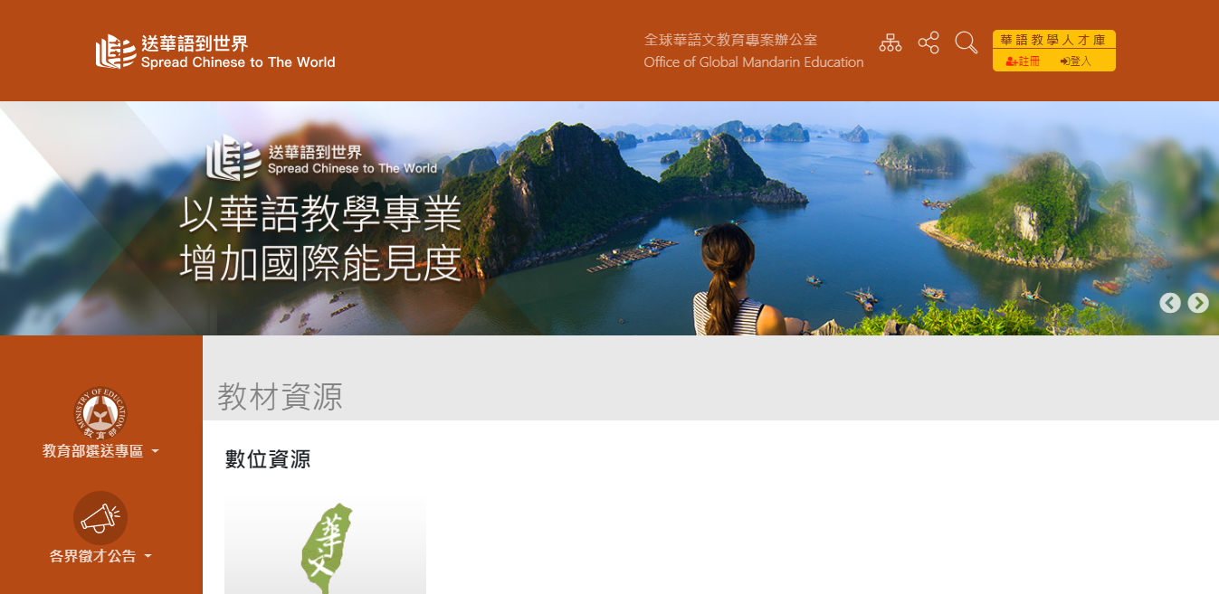
Teaching resources
Teaching resources

Slide 26
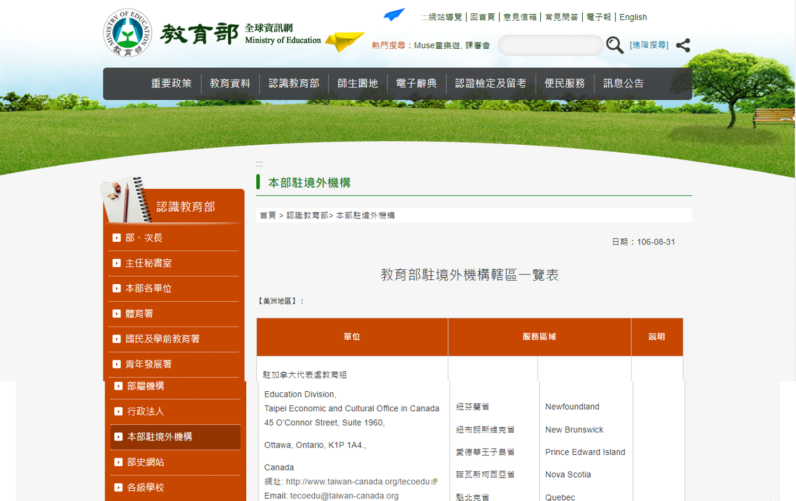
Overseas Education Divisions
Overseas Education Divisions

Slide 27
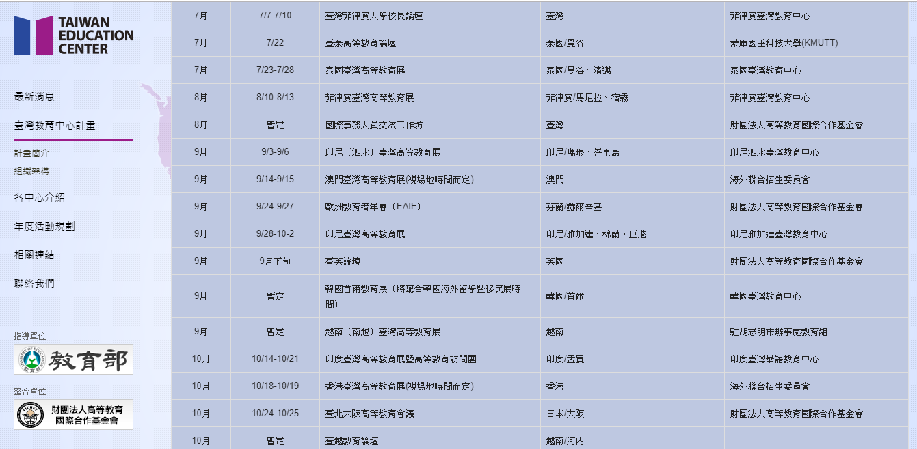
FICHET Taiwan Education Fairs
FICHET Taiwan Education Fairs

Slide 28
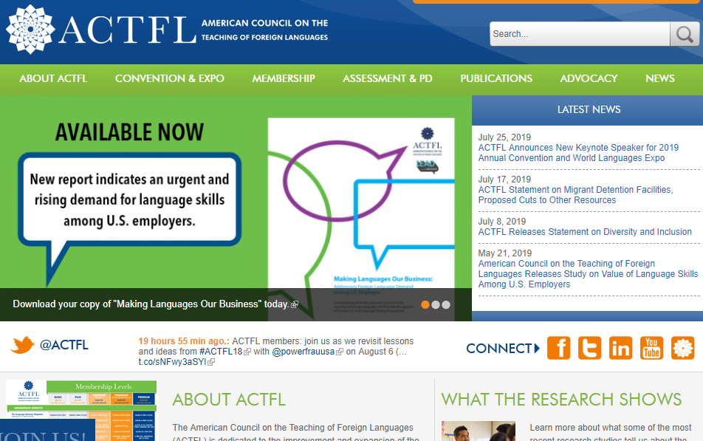
ACTFL Annual Convention
ACTFL Annual Convention

